Slide 1
Reimagining the Discovery Centre

Slide 2
How you can benefit from the lessons we learned in reinventing an educational resource library

Slide 3
Colleen Stinson cstinson@hwdsb.on.ca Senior Learning Commons Technician, Discovery Centre, Hamilton Wentworth District School Board Donna Millard dmillard@hwdsb.on.ca Supervisor, System Learning Commons and Training, Hamilton Wentworth District School Board
Notes:
Donna: Explain a bit about the various aspects of my job; Discovery Centre is only one department in my portfolio so I needed Colleen desperately!

Slide 4
Today’s Agenda
What is a Discovery Centre?
A Bit of History
From Storage Room to Library
Making Friends
Show Me the Money
Shouting it from the Rooftops
Lessons Learned and Moving Forward
Notes:
Donna

Slide 5
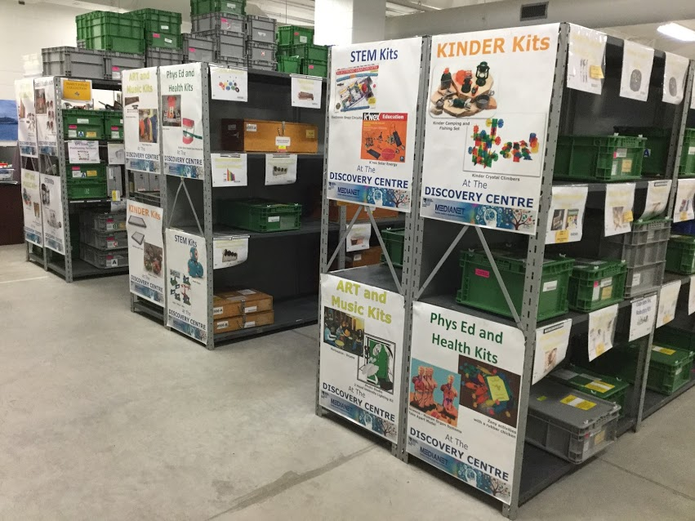
Welcome to the DISCOVERY CENTRE
Notes:
Colleen

Slide 6
What is the Discovery Centre?
Hamilton Wentworth District School Board’s
Educational Resource Lending Library
Formerly Kit Services
400+ distinct kits
1000+ copies
Multiple copies of many kits
Available FREE to all Hamilton Wentworth District School Board staff
Bookable online 24/7
Notes:
Colleen

Slide 7
What types of Educational Resources?
Robotics
STEM
Kinder
French / Bilingual
Makerspace
Musical Instrument
And more……
Sensory / Tactile / Mindful
Augmentative Communication
Social Studies
Special Needs
Physical Education / Health
Aboriginal
Notes:
Colleen

Slide 8
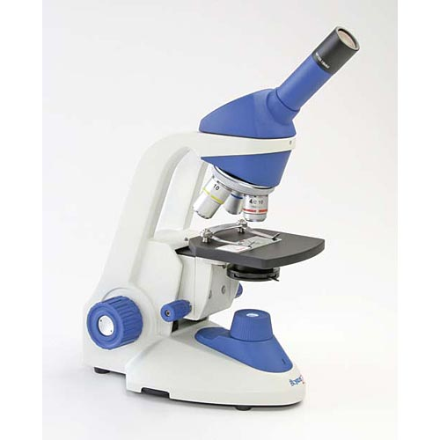
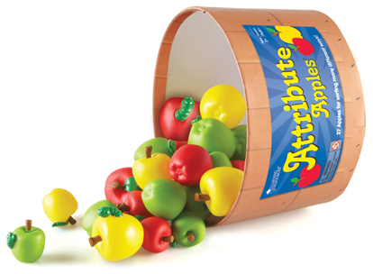
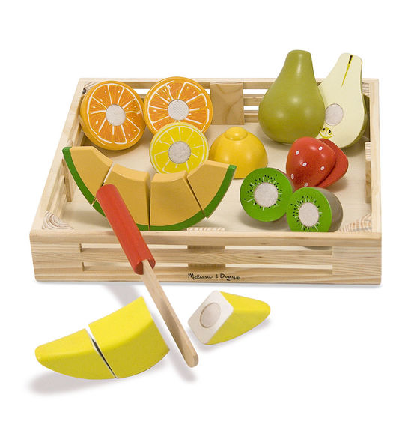
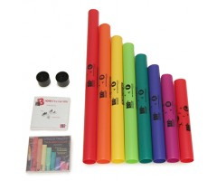
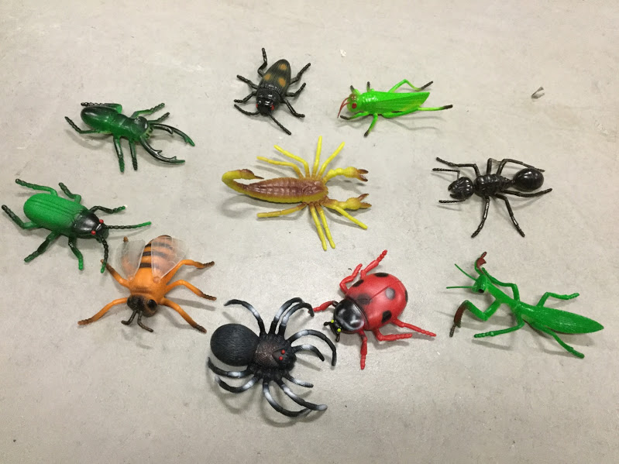
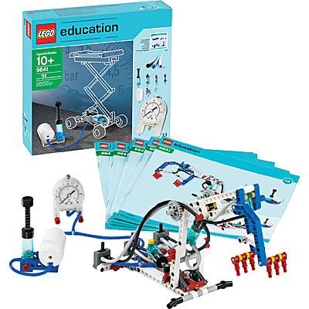
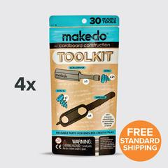
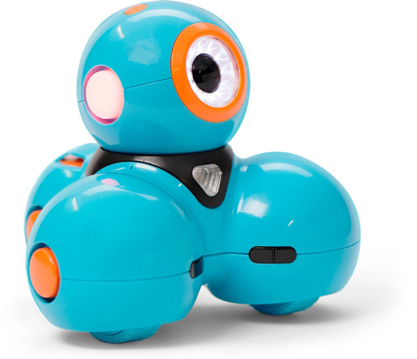
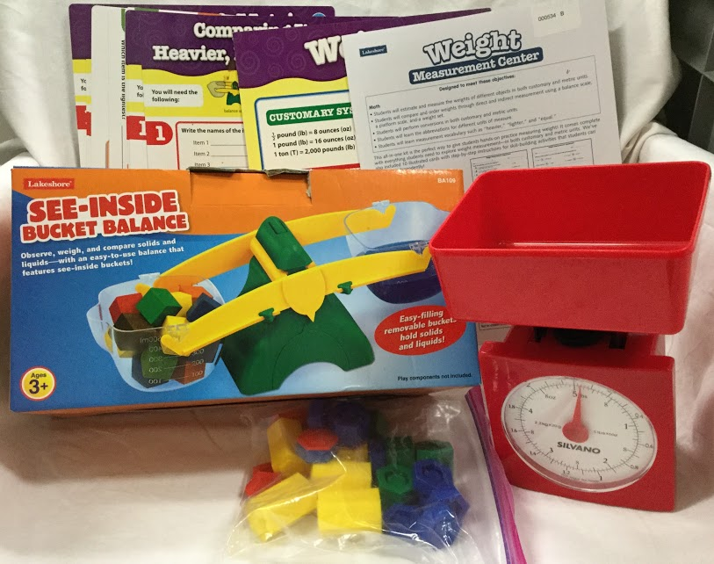
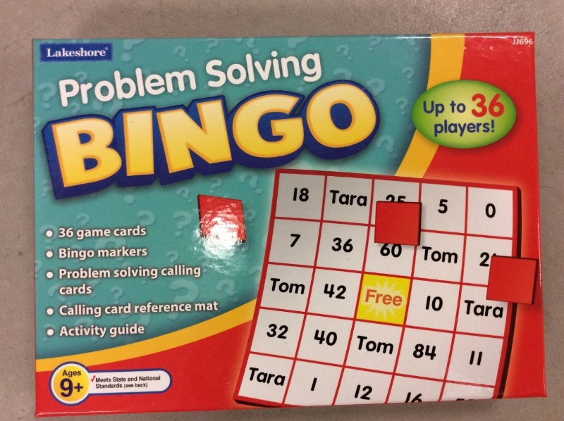
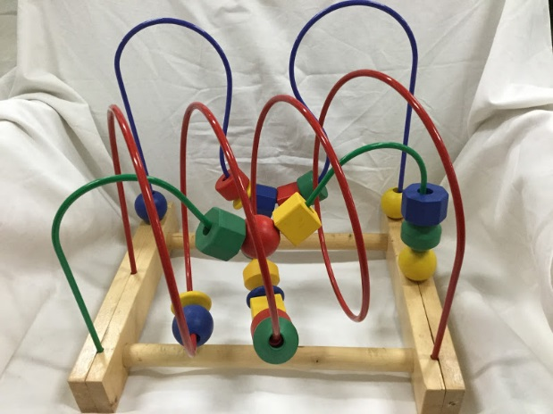
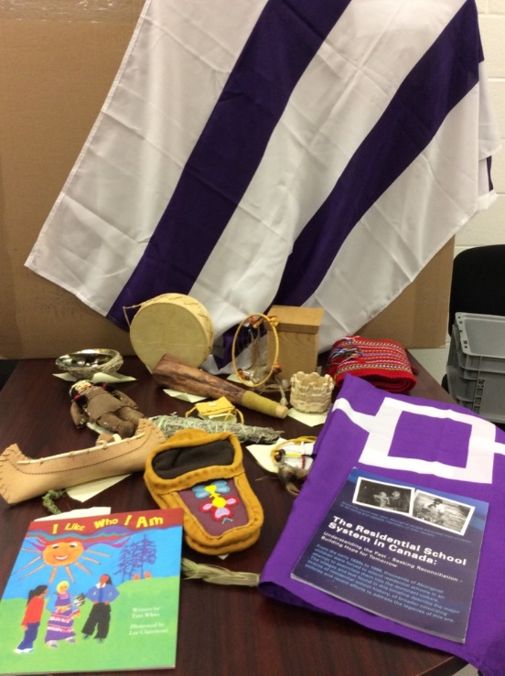
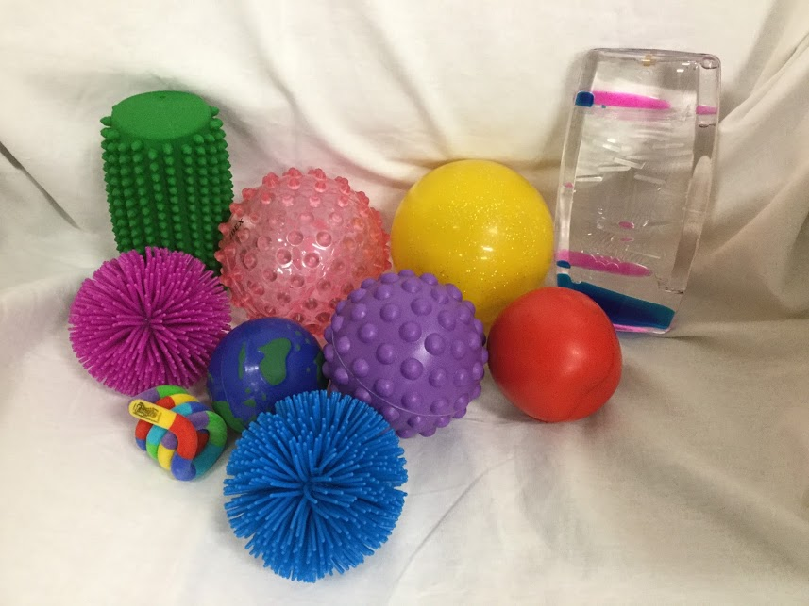
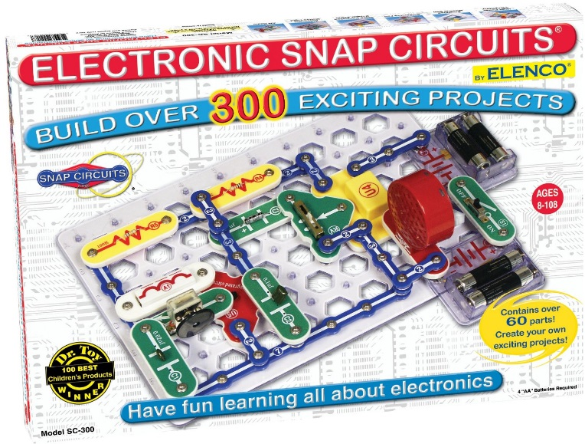
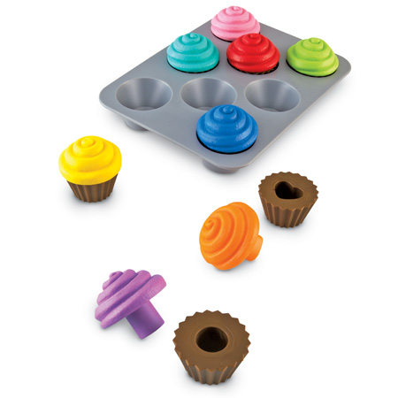
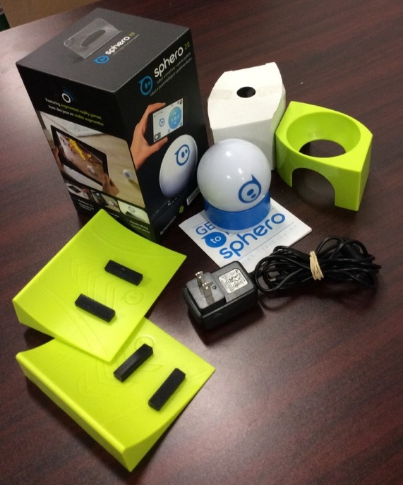
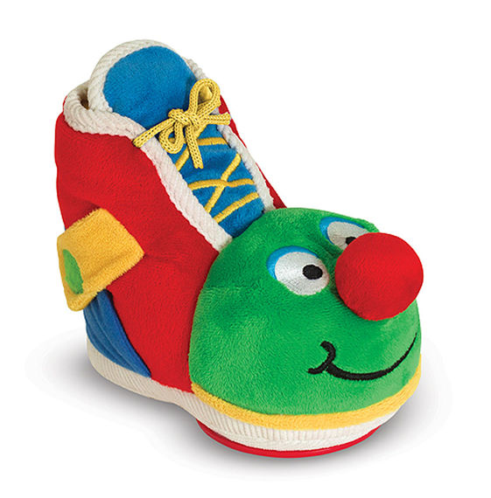
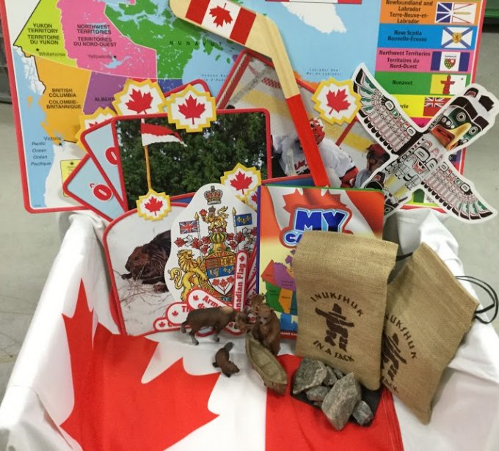
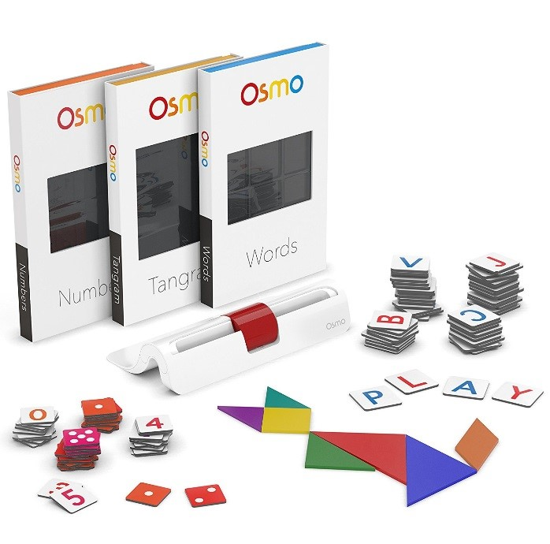
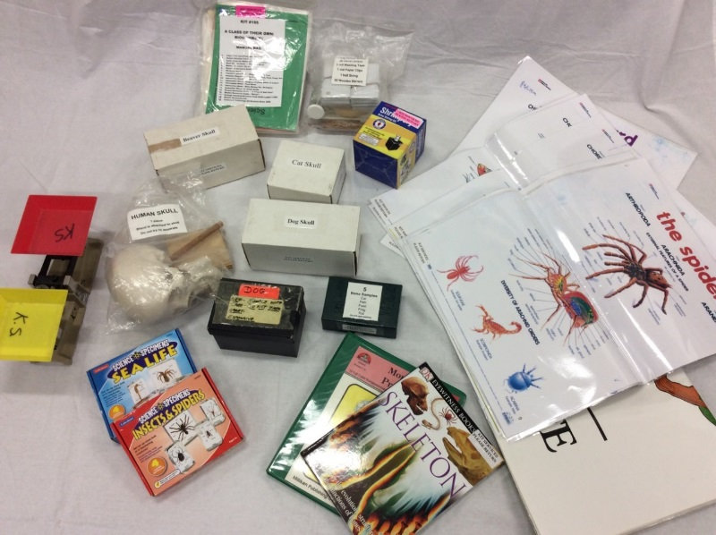
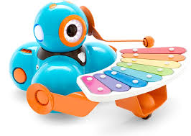
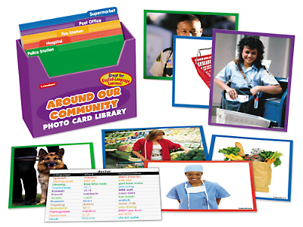
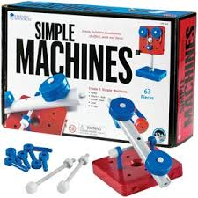
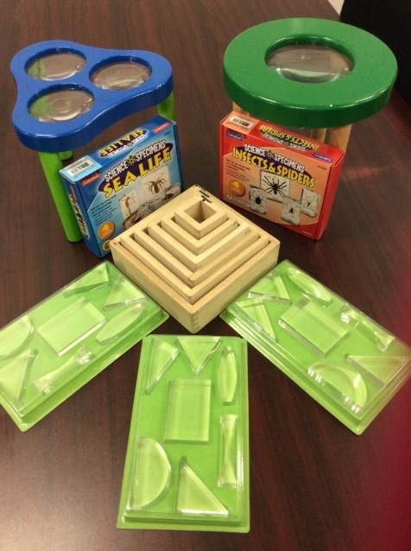
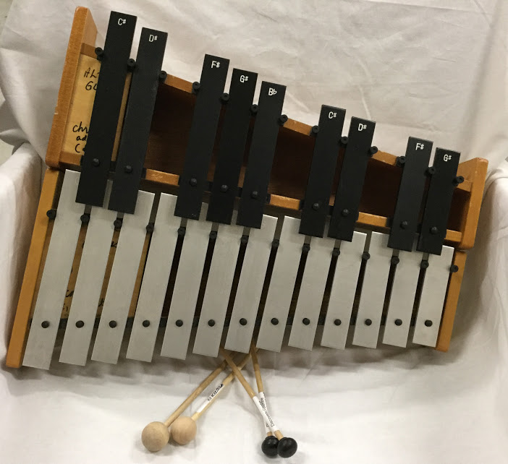
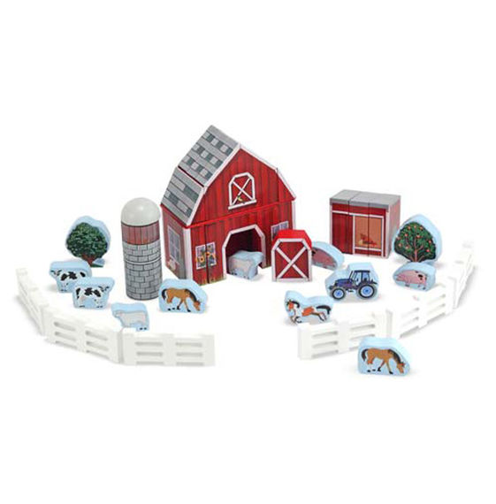
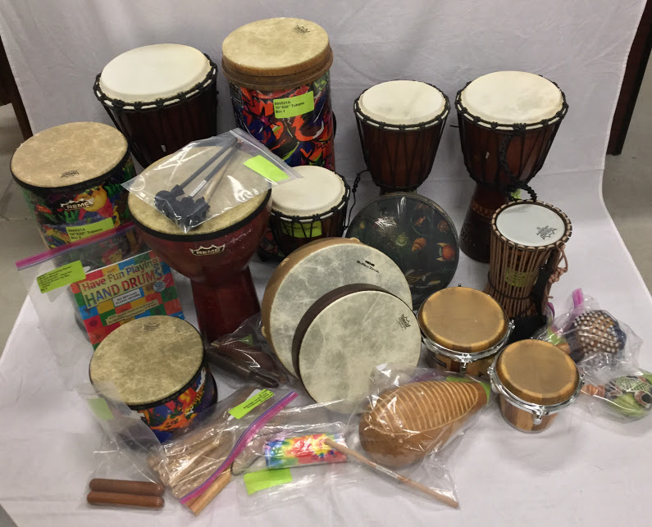
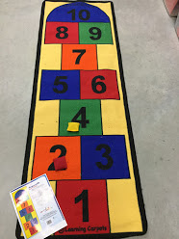
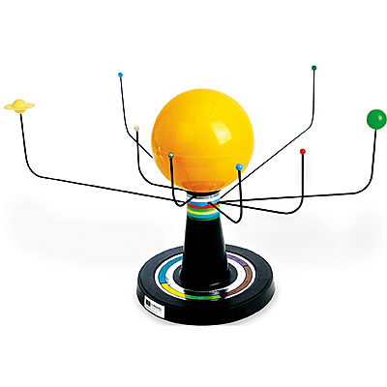
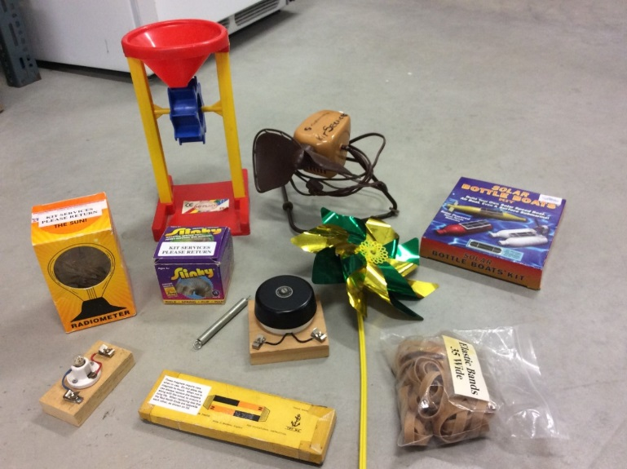
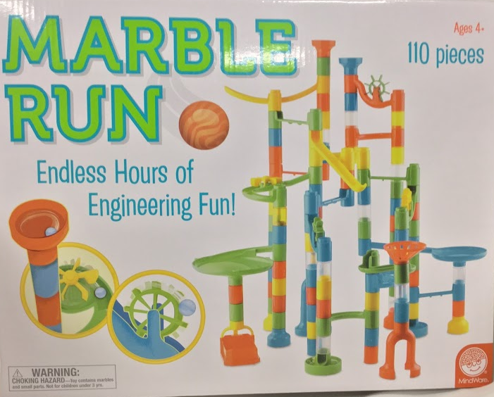
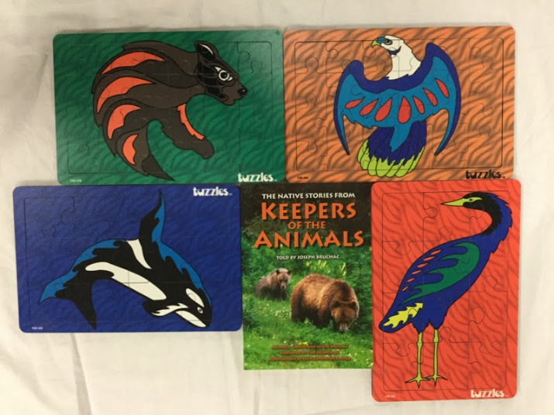
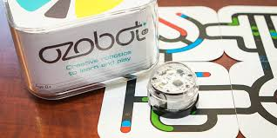
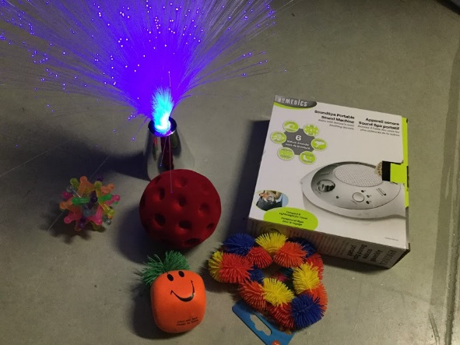
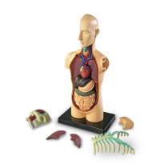
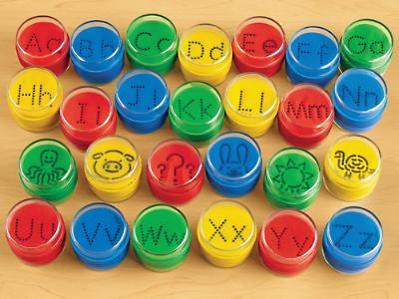
Notes:
Colleen

Slide 9
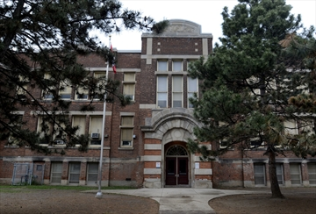
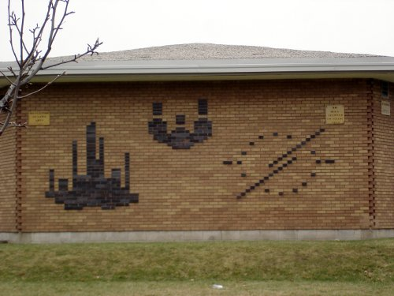
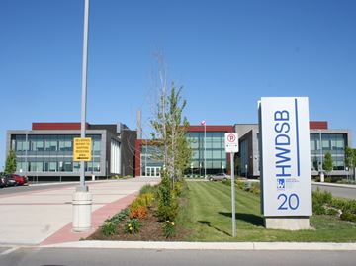
A Bit of History
Back in the 60’s - Kit Services begins out of a car trunk in shoe boxes
Back in the 70’s - First physical location in a school, then several moves
1999 - Kit Services established at Crestwood School, moves to King George (2012), Education Centre (2014)
Photos courtesy: Raise the Hammer, The Spectator, Hamilton News.
Notes:
Colleen
-Began in the 60s out of the trunks of some teacher’s cars,
-science teachers had created kits themselves and were sharing them
-the first physical location was in a school in the 70s, then it moved several times, settling at Dundurn school
-it moved again to Crestwood School in 1999, which was later demolished to build the new Education Centre so DC moved to King George school in 2012
-then to the new Education Centre at the old Crestwood site.

Slide 10
A Bit of History
In the 60’s - Started by science teachers with science kits. Over time it expanded to math, science, phys ed, puppets.
In the 70’s and 80’s - Shoe boxes changed to heavy plywood boxes
In the 2000’s - Chemicals from science kits removed for health and safety. Plywood boxes replaced with lighter plastic bins
2010 - Name change to Discovery Centre
Notes:
Colleen
-a group of science teachers made kits in shoe boxes and shared them with each other out of the trunk of a car
-with time itexpanded to math, science, phys ed, puppets
-shoe boxes replaced with plywood boxes that were handmade for the kits and kit sizes grow much larger than shoe boxes (bass metallophone) (couriers affectionately refer to the large boxes as “the coffins”)
-after 2005 the science kits were paired down and the chemicals were removed for health and safety reasons, -plywood boxes were replaced with lighter plastic bins
-2010 name changed to Discovery Centre, followed by a series of moves and in 2012 misinformation that Kit Services / the Discovery Centre was closing
-there were additional staffing changes and staffing cuts and circulation declined -current staffing at 1 full time and 2 part time (up from 3 part time)

Slide 11
A Bit of History
2014 - Reimagining begins
Notes:
Colleen
-2013 Donna hired
-by 2014 Donna was taking an interest in the Discovery Centre and purchasing of some resources began again
-by 2015 Donna was partnering with Early Years
-Colleen was hired in February 2016 after a retirement
-Discovery Centre began moving full speed ahead

Slide 12
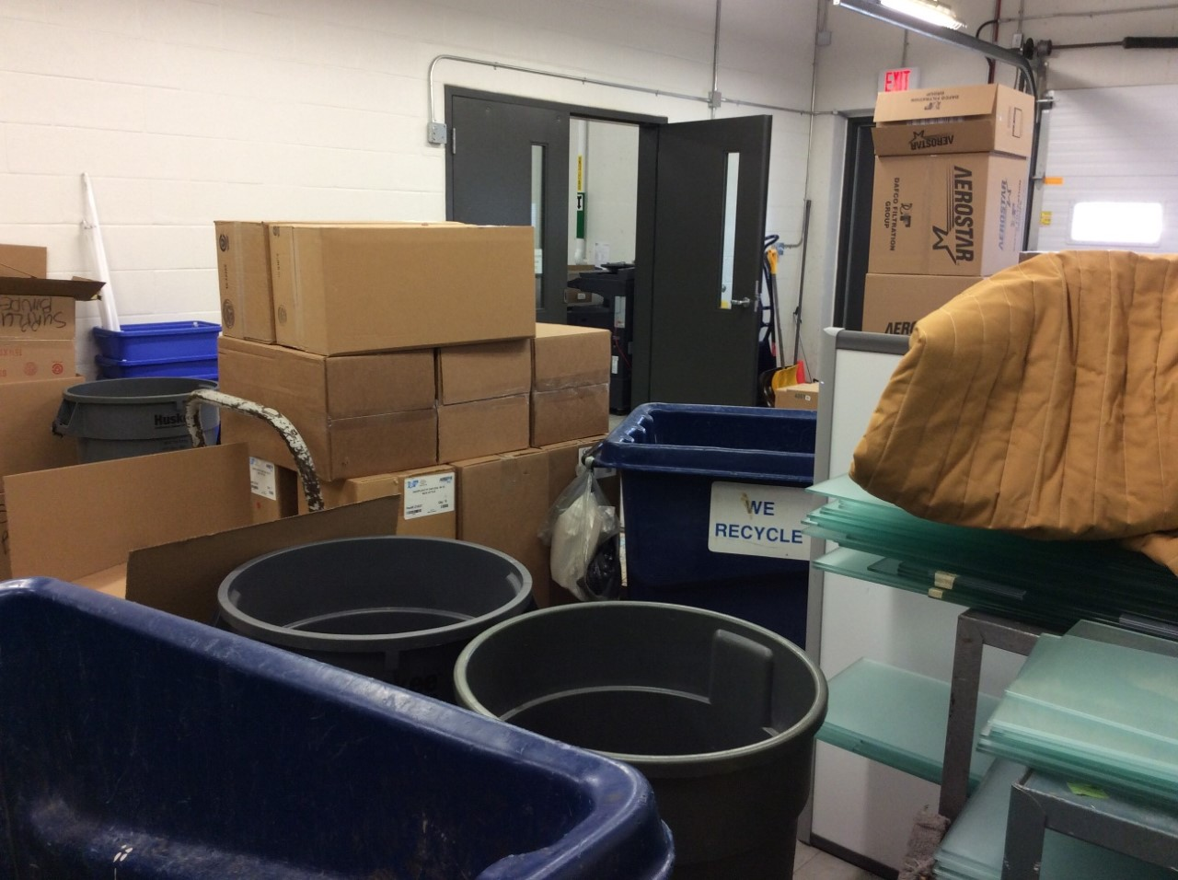
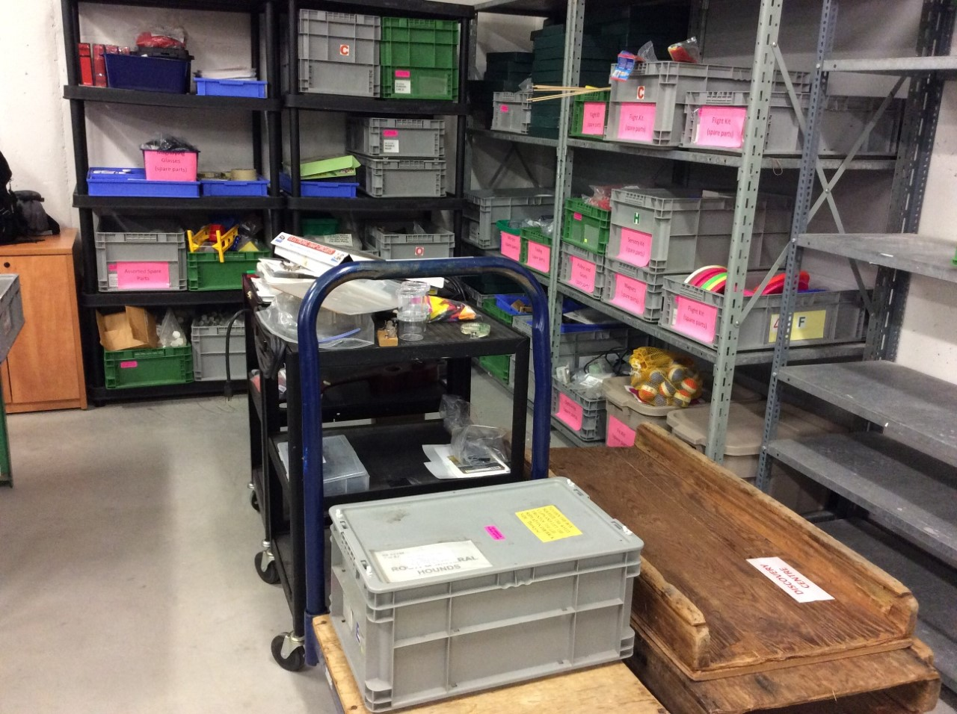
Roll back 1 Year - Feb 4, 2016
Notes:
Colleen
-Fondly referred to as “on the other side of the garbage”
-Perspective - point out loading dock, our door, door to main part of building
-Discovery Centre had a lot of clutter, was frequently mistaken for Receiving or a warehouse and was in need of some organization and new life

Slide 13
Marketing Tip #1 Keep Your User in Mind
Notes:
Colleen
Our marketing plan did not involve expensive re-branding, new slogans or logos – we are under a corporate umbrella and cannot change those things
Our marketing plan involved building partnerships and word of mouth promotion. And was FREE.
We’ll show you what we did and how you can use some of those techniques.
Marketing Tip #1 – Keep you User in mind
What do they want?
What will help our users find our services valuable?
What do our users need to be able to user our library effectively?
How can we help our users?

Slide 14
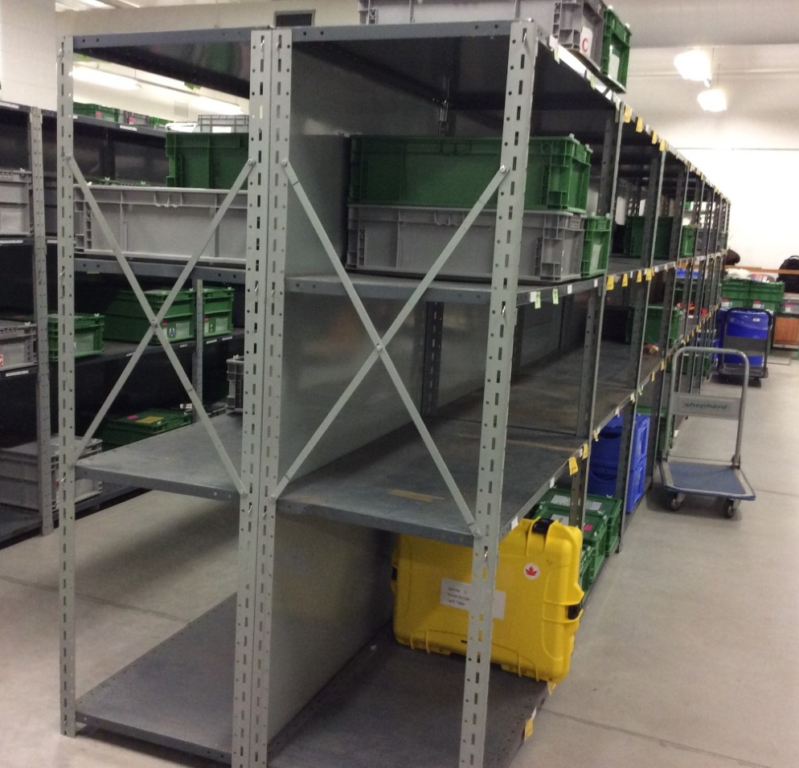
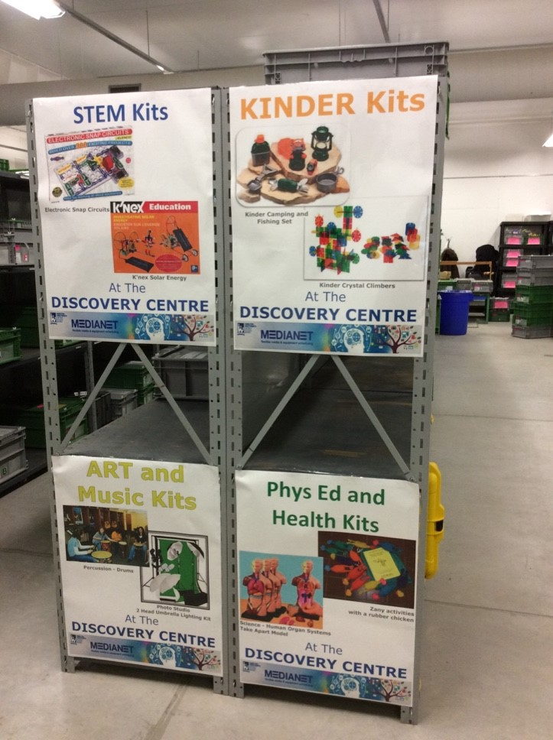
STARTING WITH THE BASICS Creating a Welcoming Space
Notes:
Colleen
-We started with the basics and created a Welcoming Space
-Can’t change industrial shelving but we can make them look less like a warehouse and more like a resource library
-Posters add colour, warmth, demonstrate our purpose and highlight our resources
-Posters also start highlighting the name “Discovery Centre” and re-creating our identity

Slide 15
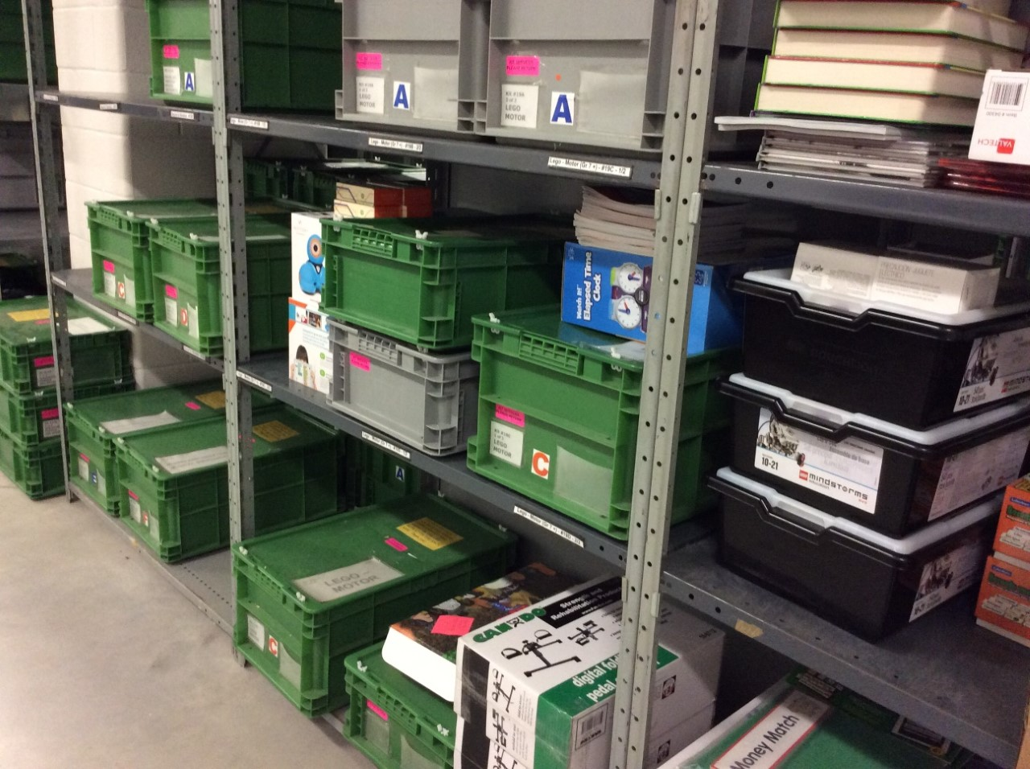
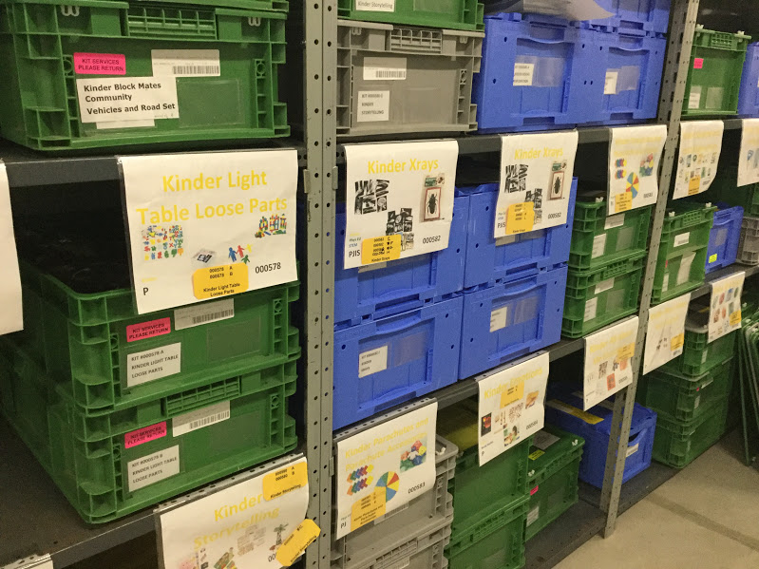
STARTING WITH THE BASICS Collection Organization
Notes:
Colleen
-Our kits are numbered but we did not have a shelving order.
-Needed to be able to reliably find resources so we created a shelving order and signage

Slide 16
STORAGE ROOM TO LIBRARY Signage
Notes:
Colleen
-Every kit has a shelf sign
-Shelf signs have 5 elements
Title
Subject or Curriculum area (Art and Music, Kinder, Language, Phys Ed, Social Studies, Special Needs, STEM) – colour coded, matches title
Audience (Primary Junior Intermediate Secondary)
Kit # and number of copies (for shelving information)
and, most importantly, a photograph of the kit contents
-Shelf Signs have added a lot of visual interest to the Discovery Centre, a lot of colour, order and organization and turned it into a browse-able collection
-A picture speaks a thousand words : can’t see into most of our bins but the pictures give a quick and thorough idea of what is in each kit

Slide 17
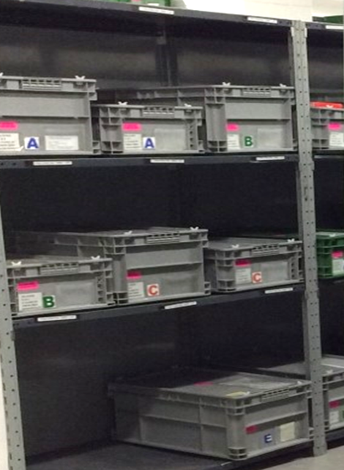
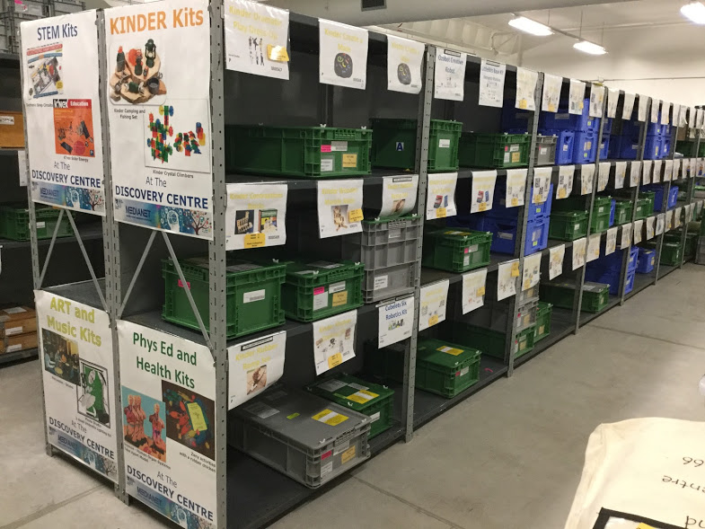
STORAGE ROOM TO LIBRARY Boxes to Browse-able
Notes:
Colleen
-Now our users can browse the Discovery Centre collection and get a better idea of what is in the boxes
(the title on the end of the box doesn’t tell you enough information to be useful)
-Teachers often wander through the collection and take pictures of the shelf signs with their iPads or smart phones to remember what kits they are interested in booking
-We now do tours and have walk in visitors, who can get a much better idea of what kinds of kits we have by just looking around and browsing

Slide 18
Marketing Tip #2 Networking
Notes:
Donna

Slide 19
Making Friends Working with other Departments
English as a Second Language
Early Years
Technological Studies
Physical Education
Language
Intensive Support Services
Aboriginal
Social Studies
Art and Music
Notes:
Donna
One word of advice— GET OUT OF YOUR OFFICE! Meet those other people interested in providing resources to students
Early Years, Intensive Support Services, Phys Ed, Technological Studies, Music,
-working our other departments within the board had been practiced before either myself or Colleen came into the roles we are now in.
-Augmentative Communication has worked with the DC for several years to circulate specialized kits for assisting students with language learning issues. These have been highly successful.
-once I started in 2013, we arranged for a group of science teachers to assist us with revamping all of our currently existing kits that had significant consumables in them. We streamlined the kits so that almost everything was reusable; consumables have now been reduced to almost nothing.
-I was also able to reach out to our Aboriginal consultant, Jennie Dupuis, and get started on updating our Indigenous kits which were desperately needing a refresh
-story about meeting Sarah Roarke, Early Years specialist on my way to a meeting. She had an enormous pile of Wintergreen boxes surrounding her cubby. Knowing what Wintergreen sold, I asked her what was in the boxes. Well, that started a great conversation regarding$100K and how she was purchasing resources for the FDK classrooms but didn't have enough funds to purchase what they needed. I mentioned the DC and what we do and the plans began. As Colleen mentioned already,a significant number of our new kits are now for those early years students.
-as a member of the 21Century learning team, I also started developing robotics kits that served the need of coding clubs and classroom activities around coding that have been taken to a new level by purchases made in the last year
-once word got out that we were developing new and exciting resources that were needed out in the schools, people started approaching us!
Colleen has established firm relationships with our intensive support services which deal with significant issues such as autism. Cause and effect kits have now been developed and are flying off the shelves. Mindfulness kits with wonder wands and Buddha boards are now available for loans.
Tech studies is now circulating fully loaded tool boxes ($700 each) for our elementary students to use. So that they are familiar with these tools in advance of coming to high school.
Our health and phys ed consultant is starting to work with us in circulating DPA resources that are new and refreshing from what is in the schools
Our art and music consultant is now helping us decide what types of instruments can be safely circulated through our services and is advising us on where to buy these resources, also donated Ukuleles ($3500); Colleen is getting very good at identifying the oddest sorts of drums! This was a great success as this was one of the relationships that needed to be rebuilt from the time that kit services was downsized.

Slide 20
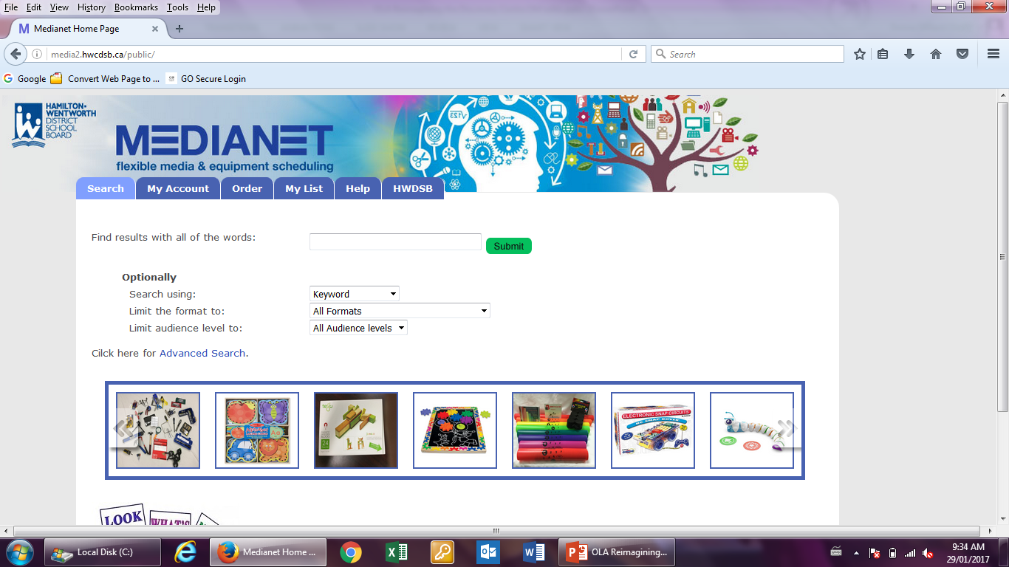
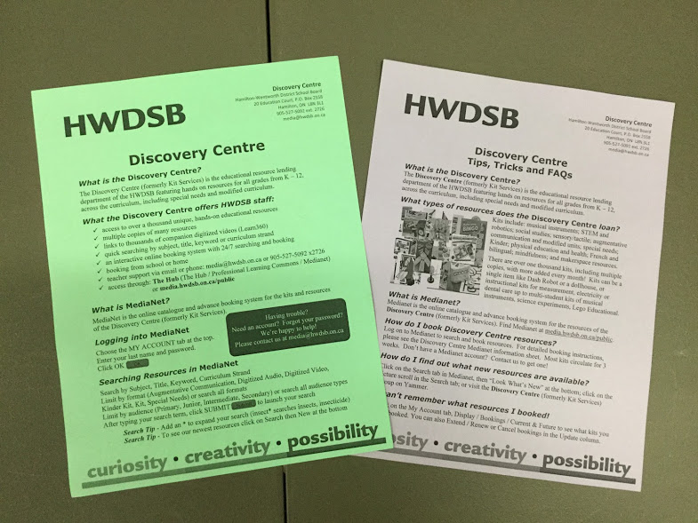
Making Friends Working with Teachers
Notes:
Donna
-a big part of making a success of the DC was re-establishing relationships with all of our teachers and not just the few die hard teachers that were using the older materials that were available. Marketing and promoting was a big part of this.
-we have had kinder, teacher librarian and social studies, ESL, EA, ISS inservices, drop in visits and booked tours throughout this term.
-specifically we held multi day open houses for Kindergarten teachers and support workers specifically but also a general open house to reintroduce the DC to everyone. We even managed to time our open house days to Trustee meetings
-word is now getting out that the Discovery Centre is alive and well and growing. We’re listening and responding to the needs of our students and their teachers.
-most recently, last Friday on our PD day, all Eas were in the building for their PD and once Colleen did an impromptu presentation on the Discovery Centre, the room was hopping for the remainder of the day!
Word of mouth is the simplest and most effective form of marketing

Slide 21
Marketing Tip #3 You don’t have to spend a lot of money
Notes:
Donna
Yes this might be a shocker to some but while some resources are super expensive, others are not.
Marketing doesn't have to be expensive either. Besides printing flyers, all of our marketing has been free.
Make the most of social media; its simple and free

Slide 22
Show Me the Money
Discovery Centre Budget
Other Departments within the Board
Early Years
Aboriginal Liaison
Technology Studies
Intensive Support Services
Ministry Grants
Community, Provincial and National Grants
Notes:
Donna
Our DC budget is pretty small but will cover the basics for replacement of missing or broken parts, new containers, labels and associated equipment, shelving (yes we buy our own shelving!)
-it is also used to pay for additional staffing when backlogs become serious; some of the funding does go to building new kits but it is pretty limited
So where have we gone to find other funding?
Other departments within the board— with the building of partnerships, come the receipt of funding. One case, our Early Years department received a significant amount to help with providing resources to all Kindergarten classes in the board. We made contact with this individual, showed them how we could distribute kits throughout the board. She was eager to join us. She used the amount to create our new set of Kinder resources which are rarely on the shelves they are being used so much.
To encourage further use and encourage financial support,we held a full day open house in the lobby of our education centre. A lot of people had no idea what resources we had. From that day,we have had further help with new kits for technology(real tool kits), Start Reading kits from Communication Services, Level 1 Cause and Effect resources from Intensive Support Services, gym resources from Phys Ed.

Slide 23
Marketing Tip #4 Communicate Communicate Communicate
Notes:
Donna
With who:
Users
Staff
Courier
Superintendents
Trustees

Slide 24
Shouting it from the Rooftops Promoting the Discovery Centre
Notes:
Donna
We used many different forms of communication including
-Open Houses,
-Displays,
-Ed Centre Pursuit,
-Presentations, Inservices, tours
Yammer (promoting every new resource)

Slide 25
Shouting it from the Rooftops Communicating with our Users
Auto Email
Delayed Item
Auto email
What is Shipping
Auto email
Items Coming Due
Email Templates
Yammer
Auto Email
Delayed Item Shipping
media@hwdsb.on.ca
Notes:
Donna
Ways we communicate with our users:
-media@hwdsb.on.ca is a consistent point of contact,
-templates for replies (consistent wording no matter which staff is replying, consistent customer service focus in the message),
-auto emails from Medianet (What is Shipping To You Today, Kits Due Back, Late, Delayed, Delayed Item Shipping), emails which were not used before
-shipping labels, How to Return this Kit labels (telling people how we would like them to return kits instead of assuming they know), Return to Discovery Centre labels (communicating with users and allowing them to communicate with us effortlessly about what direction a kit is travelling, is the teacher finished with a kit), colour coding labels
-, make life easier for everyone by providing instructions in email, labels, signage for staff in the DC (“you can’t blame them for not doing it the way you want if you didn’t tell them how you want them to do it”)
-talking to people, tours, inviting people in, small opportunities for consistent contact Reinforcing the Discovery Centre name (moving away from the Kit Services name) by putting Discovery Centre on our kit title labels, kits, How to Return this Kit label, Return to Discovery Centre label, Contents List
-Yammer – announcements (Open House, deliveries delayed due to snow day, please return our bags, booking calendar opening date, etc.), pinned resources (DC Medianet Info Sheet, DC Tips, Tricks & FAQs, pinned link to Medianet)

Slide 26
Let’s Go Shopping Rehabilitating the Collection We Have
Listening to user feedback and circulation patterns
Does this kit align with curriculum?
“When we checked the Kit, we found the following pieces missing…”
Notes:
Colleen
-Rehabilitated kits began with adding Contents Lists, (communicating what is in the kits, what may be missing so everyone knows)
-Contents Checking – every kit, every time
-Missing Pieces Tracking, emailing teachers, getting missing parts back (some kits are useless if a charger is missing)
-spare parts – large supply of parts we can replace as necessary – Lego, K’Nex, some sensory, extra pieces from withdrawn kits,
-watching circulation patterns to see what is in demand - what do we need more of?, what is not earning its shelf space?
-informal requests for new resources from Consultants and Educational Coaches and teachers (Yammer, talking in halls, emails –do you have…)
-do our kits align with curriculum (class sets versus smaller group in individual resources)
-weeding kits
-re-evaluating kits with our expert contacts in other departments (e.g. science Ed Coaches to evaluate older science kits, Intensive Support Services staff helping to improve AC kits which have missing pieces)

Slide 27
Let’s Go Shopping Adding New Resources (on a budget)
SALE!!!
Smaller Footprint
Outlet
Notes:
Colleen
-added over 450 new kits copies, almost doubled collection size in 18 months
-expanding the types of resources, more than just STEM resource, expanded across the curriculum – language, educational games, makerspace, exceptional student resources (learning resource, life skills, sensory), social studies, ESL
-grade K – 12, kits for all students of all abilities
-using products in new ways – Canada Bulletin Board kit with labels in French and English becomes a bilingual matching game and the foundation of our Canadian Symbols kit
-introduced 2 new format types (Kinder, Special Needs)
-Robots (Ozobot, Cubelets, DASH, DASH Accessories, Sphero 2.0, Sphero SPRK, Sphero Accessories, Code-a-pillar)
-teacher requests (Dip Nets story, Educational Coach emailed my on a Thursday night, bought kits and special bin, processed on Monday, shipped to teacher on Tuesday)
-circulating resources for other departments (AC, ISS, Phys Ed., Tech)
-smaller kits in smaller packages, group not class sets, 1 resource in a kit instead of an entire packaged unit
-smaller, lighter clear boxes
-discount vendors, Boxing Day Sales, clearance sales, Vendor outlets and remainders, thrift stores, plus regular educational vendors
-average cost of kits from hundreds or thousands of dollars (ToneChime Bells = $2000, drums = $5000, lego sets = $1500) down to an average of $100 per kit. Some kits as little as $12 or $14. (2 resources in slide cost us less than $15 for a kit, 1 about $22, 1 was donated, one used surplus parts from Spare ). Free resources from Elections Canada. We can get a lot more kits for the same money.
-as Donna mentioned, our budget also covers new shelving to hold all the new resources, new bins for the resources (bought on sale, of course), foam cushioning for fragile resources, so we need to stretch our resource budget
-Having more resources to promote means increased marketing. Each new resource Yammered in another marketing interaction with our users.

Slide 28
Almost De-Railed Finding a Creative (an inexpensive) transportation solution
Notes:
Colleen
-Funding that paid for our courier was cut in June 2016, just as circulation was really starting to take off
-New courier, combined with Mail Services, balancing act – the needs of 2 departments plus all the schools
-New shipping Routes (needed to change shipping routes, shipping schedules, pick up order in our booking system)
-Colours coded routes, packs by colour, signs on the wall where we put the packs for different colour routes, coloured school delivery labels, coloured highlighting on shipping labels - all consistently communicated
-absolute consistency to be able to keep 4 routes and 100+ and ships over 130 items schools organized
-pack sizes doubled, then tripled, and quadrupled
-how to manage pack sizes – got a cargo van then needed to upgrade to a cube truck, pack barely fit in van many days
-communication with our drivers – communicating pack sizes in advance, working with them for late kit pick up and delayed kit delivery on off day, they let us know valuable information about how our shipping is working, messages from schools and teachers
-Accuracy, accuracy, accuracy – pack sizes are so big now that we Double Check everything we ship to make sure there are no error – customer service. If there are problems, I email teachers immediately to let them know the problem and explain how we will fix it

Slide 29
Marketing Tip #5 Communicate some more
Notes:
Donna
Communicate with:
-Other departments
-Board Administration—latest success, I will be presenting the successes and needs of the Discovery Centre to our Executive Council in March
-our teacher clients (repeatedly an in many ways); using these teachers as our sales people out in school. Again word of mouth works miracles.
-teachers who don’t know us yet
-Educational Coaches and Consultants
-schools, principals and secretaries
-our couriers
-Discovery Centre staff
-other SLC and IIT staff
Basically, the more we send out a consistent message that we are here, willing to listen and respond to needs, the more successful we are

Slide 30
Communication Our Secret Weapon
Yammer
Presentations
THANK YOU
Email
Instructions
Face to Face
Notes:
Colleen
Ways we Communicate : on kits ; email templates ; flyers ; communication to staff (instructions posted on walls, templates in inboxes), thanking people A LOT
Can find communication successes from identify finding short fallings – Story - adding “Delayed kit shipping to you today” email because kits were getting lost in schools when delayed kits shipped without teachers knowing
CONSISTENT, CONSISTENT, CONSISTENT
-Phrase things in the positive: People want to help, want to success (in booking resources, returning kits on time…) Say “Please do this” instead of “Don’t do this”
-Keep it simple: we use colours a lot – route colours ; school labels ; school route lists ; pack location signs. Matching colour on “How to Return this kit” instructions and “Return to Discovery Centre labels” ; yellow contents lists (always yellow) ; red instruction sheets (Contains latex, Caution Sharpe, Please dry thoroughly before returning)
-Font Colour – use green (go) to get attention not red (stop – unless you want them to stop, like in warning signs)

Slide 31
Feedback You Know More Than You Think You Know
Does the way we do it make the most sense?
What we hear from school staff
Can we do it better?
What we hear from the courier
What caused this unusual result?
What we hear from Consultants and Instructional Coaches
Why do we do it this way?
What the statistics say
What do our users think we mean?
Notes:
Colleen
Listening, who are we hearing from? How are we hearing from them in non-traditional feedback?
-Couriers tell us a lot: movement issues, kits that sit at a school without being touched (teacher sick?), kits that return early (kit not appropriate for the audience, kit incomplete?), packaging issues, problems with circulation dates, ebbs and flows in shipping
-School Staff: teacher off sick – do we need to cancel bookings? ; kits lost in school – other teachers taking kits that weren’t booked by them, how can we manage? ; problems with drop off location – can we improve it?
-Consultants / Instructional Coaches – holes in the collection, areas to develop, changing curriculum – do kits need to be modified?
-Are there consistent mistakes? – what do our users think we mean? What caused this unusual result?
-What can we make better?, challenges into successes, “why are we having problems with this?”
-Return instructions - We can’t blame them for not doing what we want if we didn’t tell them what we want
-Kit contents, what breaks consistently – do we need to replace it with something else?
-Heard in the bathroom – strange but true. Very popular tour last week, people were talking in the bathroom, others heard and came to tour the DC
-Comments from people touring DC – “This is the best in-service I’ve ever been to” – communicate this with Donna, her manager, superintendent. What can we do to read the people who the DC is very valuable for?
You really do know more than you think you know.

Slide 32
Feedback If you don’t know…Ask
“Please feel free to contact us at any time.”
Notes:
Colleen
-Formal Feedback survey in kits just begun, going for 1 semester
-Don’t ignore feedback – story about teacher requesting a picture of how to set up monster bowling pins. We thought it was too simple, but is it too simple for a kindergarten student? Would it help the teacher to include this? How hard would it be to implement? Story 2 – teacher said kit was too challenging for her grade 3 student. I knew the kit was too hard for grade 3. Why didn’t she? Is out audience code obvious enough? Do they read our records? Can we make it more clear? – Both feedbacks in week 1 of returning surveys with only a couple returned.
-Feedback on website (almost no one uses, what do we need to do to make it more user friendly – not using the feedback form is feedback about our feedback form)
-inviting contact through media@hwdsb.on.ca, “Please feel free to contact us at any time” in every email, and we mean it!
-following up on concerns and telling people how we fixed the problem – we are providing feedback
-notes from teachers – what are they telling us, how can we improve frequent problems

Slide 33
Lessons Learned and Moving Forward
Notes:
Donna
So our reimagining of the Discovery Centre has been successful to date. But what have we learned to date and what are our issues moving forward?

Slide 34
What’s in a Name? Managing an Identity Crisis
Kit Services
Discovery Centre
(formerly Kit Services)
Discovery Centre
Notes:
Donna
Name Change, “Is that what you’re called now?”, “I thought they were closed.”
To get Discovery Centre into people’s minds, it means constant and consistent communication. This means written, verbal and social media formats. All need to be consistent to be successful.
We’re still not there yet but we expect, with consistent communication, it will happen over a few years.

Slide 35
What’s in a Name? Updating Our Image
Customer Service
focused
Consistent
Colours
Intentional
decisions
Templates
Notes:
Donna
Customer Services focused, Every decision has a purpose (bin labels, letter templates, colours, Medianet updates)
Discovery Centre will be associated with exemplary service, providing needed and timely resources, and with a service orientation based on problem solving and working collaboratively with our clients.

Slide 36
Triple It Up Our Circulation Goals and How To Get There
5500 items
348% increase
450 new resources
254% increase
4000 items
5000 items
Notes:
Donna
One way to get support from our superintendents is statistics.
We’ve added new resources, are working on refreshing older kits and the results are apparent!

Slide 37
Moving Forward Issues and How to Develop Solutions QUESTIONS?
Notes:
Donna and Colleen
Space—we’re running out of space in our storage area. We need to get creative and thoughtful on what to keep and what not to keep. Do we need really large kits any longer? Can we combine physical items with some virtual reality sources to give a dual experience? All of these ideas need to be explored to keep us relevant but not bursting at the seam.
Staffing—we don’t have enough! The equivalent of 2 full time staff does not equate with the circulation stats we are now seeing. That is why I’m excited to be going to executive council to sing of our successes but to draw attention to the staffing issues in this area.
Development money—we need to continue exploring the sharing of resource funding with other departments we haven’t yet contacted at the board office. We also need to start exploring other grants that may be possible for us to get resources from.
Marketing focus—we will continue to market our resources and services, developing new kits as we see a need from our clients, advertising out what we have and how to get it; improving on both written and verbal communication that is consistent is very very important
Q & A
Have some stories ready to go to fill time if necessary – how a booking calendar differs from library circulation, types of resources we have versus library, etc.

Slide 38
Colleen Stinson cstinson@hwdsb.on.ca Senior Learning Commons Technician, Discovery Centre, Hamilton Wentworth District School Board Donna Millard dmillard@hwdsb.on.ca Supervisor, System Learning Commons and Training, Hamilton Wentworth District School Board

